Slide 1

Kentucky 4-H
LIVESTOCK VALIDATION AND SHOWS
Washington County Extension Office

Slide 2
I’VE BOUGHT MY PROJECT ANIMALS. NOW WHAT?
  Complete a Premises ID Request Form
  Sign up for a Validation Site
  Complete a Validation Form
  Hold Harmless Agreement
  Attend Validation

Slide 3
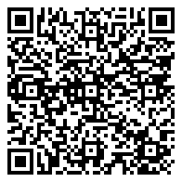
PREMISES ID REQUEST FORM

Slide 4
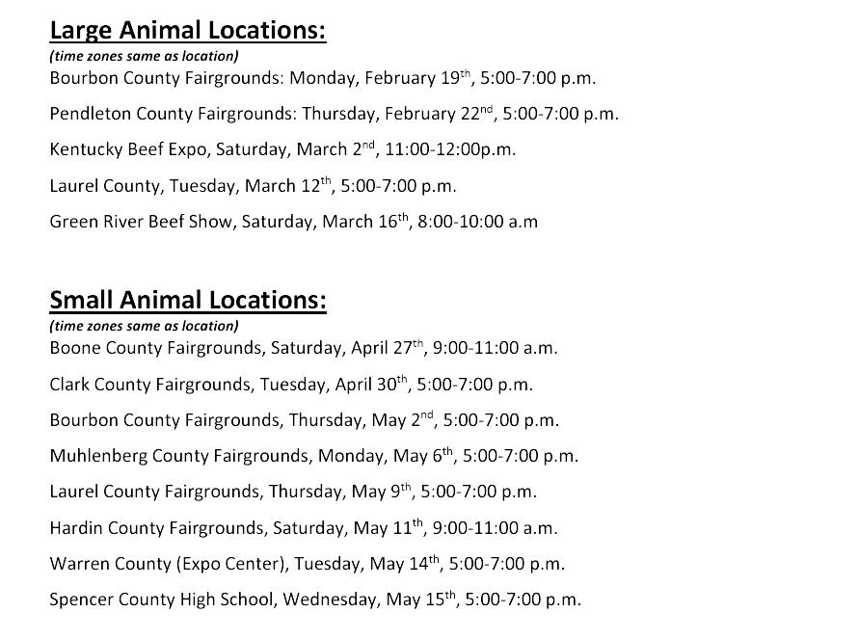
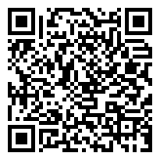
VALIDATION SITES

Slide 5
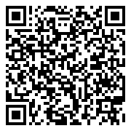
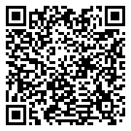
VALIDATION SIGN UPS
Small Animal
Beef

Slide 6
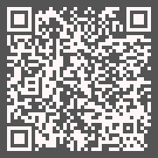
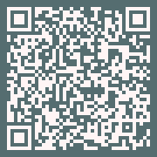
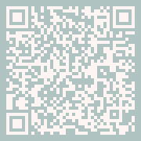
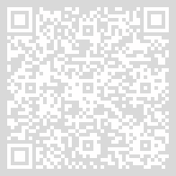
Validation Forms
SHEEP
GOAT
SWINE
BEEF
7

Slide 7
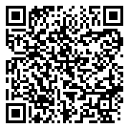
HOLD HARMLESS AGREEMENT

Slide 8
ATTEND VALIDATION
A representative from the Kentucky Department of Agriculture Shows and Fairs and Livestock Health Department will be there to assist in Tagging and Pulling DNA.
Taggers and Pliers will be provided.

Slide 9
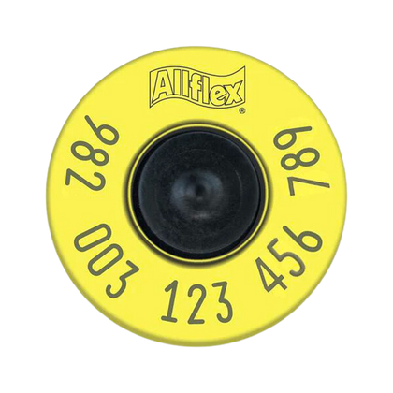
TAGGING AND DNA SAMPLING
All 4-H/FFA market steers, market heifers, market lambs, market hogs, and market goats that will participate in market livestock shows in Kentucky (i.e., County Fairs, District Shows, Junior Livestock Expos, Kentucky State Fair, etc.) must be tagged with Radio Frequency Identification (R.F.I.D.) tags. The R.F.I.D. tag number will be used as the Kentucky Uniform Identification Program (K.U.I.P.) number.
In addition, to be eligible for participation in the Kentucky State Fair, market steers, market lambs, market hogs, and market goats must have samples collected for DNA testing.

Slide 10
TAKE ANIMALS HOME
  Monitor the animal for any signs of stress on the day of. Be sure to provide clean fresh water the day of. Consider bringing some with you to the site. Lines can be longgggg!
  Monitor the tag for any signs of infection. I often clean mine with alcohol or peroxide to help prevent this.

Slide 11
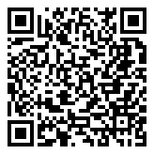
SHOW TIME
In order to compete at the Kentucky State Fair with a market animal you must attend at LEAST one district show.
To show at a district show you should have the following:
  Completed the validation process
  Have a valid set of health papers (CVI)
  Registration Papers for Breeding Stock

Slide 12
NEW FOR 2024
  All youth who wish to exhibit market livestock and/or breeding swine at either KDA District Shows or the Kentucky State Fair must complete the Livestock Validation Process. This process requires in-person tagging at one of the official validation sites.
  Breeding animal nomination forms are no longer required for any species. Please note that all swine must be validated and receive a KUIP tag.
  All exhibitors are required to have a National Premises ID before coming to the Validation Site. If the location where the animal will be housed has a National Premise ID, that number will be used. If the location where the animal will be housed does not have a National Premise ID, please follow the steps in the attached document to secure one prior to travel to the Validation Site. No animals will be tagged without a National Premise ID.

Slide 13
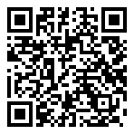

PAGES TO WATCH
University of Kentucky Animal Validation Webpage
  Kentucky Department of Agriculture Shows and Fairs Facebook
  Kentucky State Fair Website and Facebook

Slide 14
6 Tips for bringing projects home
Clean and disinfect EVERYTHING in the barn and bringing animals home.
Give them a couple days to settle into their new environment before starting your daily routine.
Have all supplies purchased. Ask you breeder what they are feeding to make for an easy transition.
Start looking at show schedules to plan your show outings. KDA Show Schedule
With your family… Write down your yearly goals and a plan to make them happen.
Make sure your barn temperature is comfortable and eliminate any drafts.

